Slide 1
CSS 422 Hardware and Computer Organization
ARM Assembler
Ver. 3
Professor: Munehiro Fukuda

Slide 2
Topics
CPU Architecture from System Programming Viewpoint
User versus OS
Interrupts and exceptions
Mechanism of Program Execution
Cortex reset sequence
Assembler directives to support the reset
The complete 1st assembly program
Keil uVersion
How to install, write, compile, and run your program

Slide 3

User Programs versus OS
User Application
Unprivileged & User Stack (Process Stack in ARM)
main( ) {
cin >> name;
cout << “hi! ” << name << endl;
}
User Stack
Device interrupts
System calls
Exceptions, (e.g. seg fault)
Exception return
Operating System
Privileged & OS Stack (Main Stack in ARM)
OS Stack

Slide 4
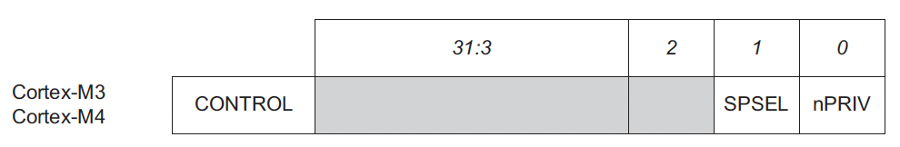
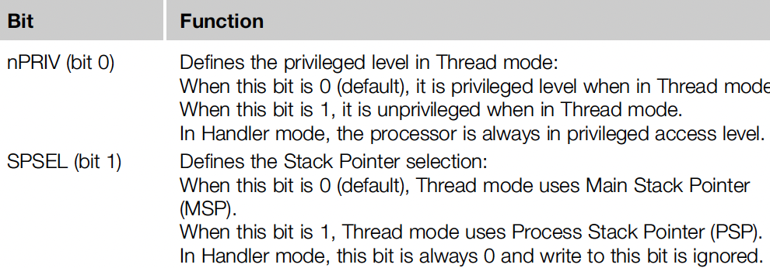
Processor Operating Mode
CONTROL-Bit1 = 0
Handler Mode must manually switch SPSEL from 0 to 1 upon a reset in order to run a user program in unprivileged thread mode.
MOVS R0, #3 ;Set SPSEL bit 1, nPriv bit 1
MSR CONTROL, R0 ; Now thread mode uses PSP for user
CONTROL-Bit1 = 1

Slide 5
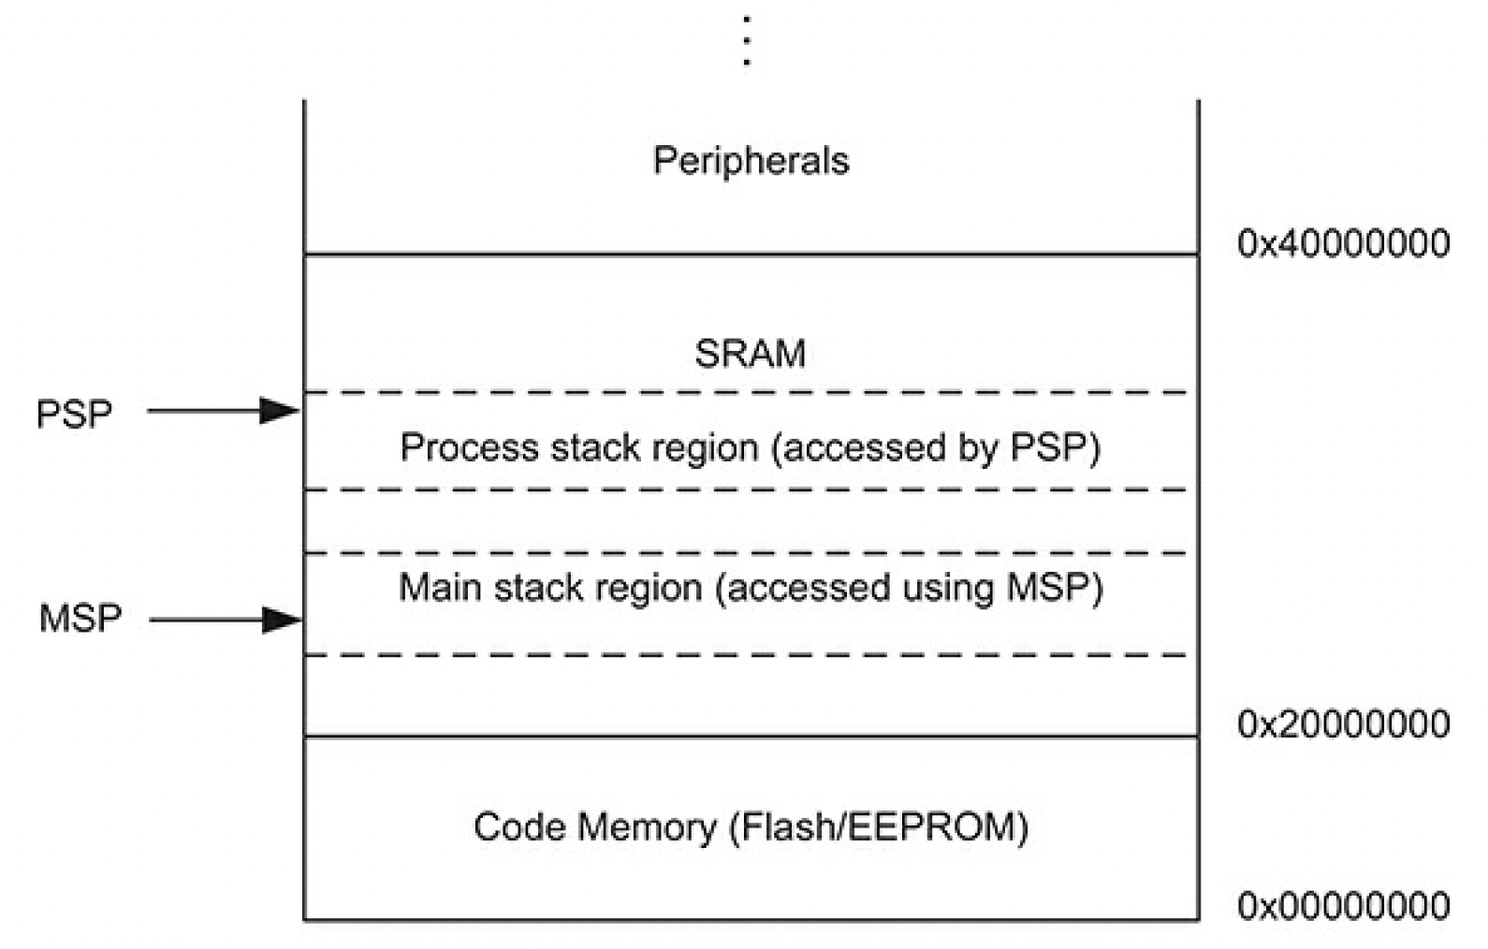
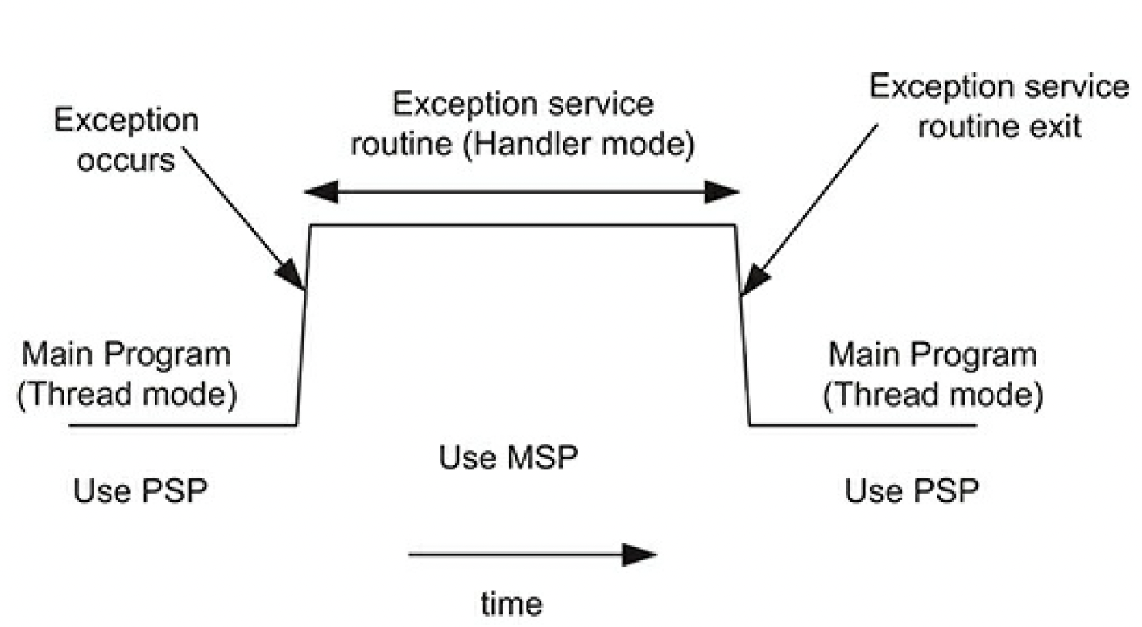
System Stack Architecture
Process Stack Pointer
(Used by User Applications)
Main Stack Pointer
(Used by OS)

Slide 6
Exception Types
#13 System timer
Upon an exception asserted, CPU changes into the handler mode, and jumps to the interrupt vector table.
#1 Reset
#3 Hard Fault (caused by #4-#6)
#4 MM Fault (e.g. page fault)
#5 Bus Fault (memory access errors)
#6 Usage Fault (e.g. zero division)
#11 SVC (i.e. system calls)
#2 Non-Maskable Interrupt
# 16 Interrupt 0
...
#255 Interrupt 239
From integraed/external peripheral devices

Slide 7
Interrupt Vector Table
__Vectors DCD __initial_sp ; Top of Stack
DCD Reset_Handler ; Reset Handler
DCD NMI_Handler ; NMI Handler
DCD HardFault_Handler ; Hard Fault Handler
DCD MemManage_Handler ; MPU Fault Handler
DCD BusFault_Handler ; Bus Fault Handler
DCD UsageFault_Handler ; Usage Fault Handler
; Reset Handler
Reset_Handler PROC
EXPORT Reset_Handler [WEAK]
IMPORT SystemInit
IMPORT __main
LDR R0, =SystemInit
BLX R0
LDR R0, =__main
BX R0
ENDP
; Dummy Exception Handlers (infinite loops which can be modified)
NMI_Handler PROC
EXPORT NMI_Handler [WEAK]
B .
ENDP
Incoming exceptions
Need to implement how to handle

Slide 8
Reset Sequence

Slide 9
Assembler Directives
Directives | Descriptions | Examples
EQU | Gives a symbolic name to a numeric constant. | Stack_Size EQU 0x00000200
AREA | Assembles a new code or data section | AREA STACK, NOINIT, READWRITE, ALGIN=3
ENTRY | Declares an entry point to a program. | ENTRY
SPACE | Reserves a zeroed block of memory. | Stack_mem SPACE Stack_Size
PRESERVE8 | 8-byte alignment in stack.
THUMB | Marks the THUMB mode of operation. | THUMB
EXPORT | Make a given symbol visible to the other source files. | EXPORT __Vectors
IMPORT | Resolve a given symbol as one that was defined in a different source file. | IMPORT SystemInit
DCD | Allocates one or more words. | DCD Stack_mem + Stack_Size
DCB | Allocates one or more bytes. | C_string DCB "C_string",0
ALIGN | Align the current location to a specific boundary | ALIGN 8 ; aligned on 8-byte boundary
END | Tells the end of the source file. | END

Slide 10
Complete 1st Assembly Program
THUMB ; Marks the THUMB mode of operation
StackSize EQU 0x00000100 ; Define stack size of 256 bytes
AREA STACK, NOINIT, READWRITE, ALIGN=3
MyStackMem SPACE StackSize
AREA RESET, READONLY
EXPORT __Vectors
__Vectors
DCD MyStackMem + StackSize ; stack pointer for empty stack: 0x2000.0100
DCD Reset_Handler ; reset vector 0x0000.0008-0009
AREA MYCODE, CODE, READONLY
ENTRY
EXPORT Reset_Handler
Reset_Handler
MOV R0, #0 ; initialize value of sum
MOV R1, #2 ; First even number
MOV R2, #5 ; Counter for the loop iterations
lbegin
CBZ R2, lend ; Terminate loop if counter is zero
ADD R0, R1 ; Build the sum
ADD R1, #2 ; Generate next even number
SUB R2, #1 ; Decrement the number
B lbegin
lend
B lend
END
__Vectors
0x0000.0000
0x0000.0004
0x0000.0008
0x0000.000C
0x0000.0010
0x0000.0014
0x0000.0016
0x0000.0018
0x0000.001C
0x0000.0020
0X0000.0022
0x2000.0100
Reset_Handler
0x0000.0009
MOV R0, #0
MOV R1, #2
MOV R2, #5
CBZ R2, 0x22
ADD R0, R1
ADD R1, #2
SUB R2, #1
B 0x14
B 0x22
Code Space (ROM)
MyStackMem
0x2000.0000
...
...
0x2000.0100
MyStackMem+StackSize
Stack Pointer
(RAM)
This program considers only exception #1: reset in its interrupt vector table.

Slide 11
Keil uVersion
Keil MDK is an ARM software development environment: https://www2.keil.com/mdk5
Keil uVersion is a free software as a subset of Keil MDK: https://www2.keil.com/mdk5/uvision/
The main difference from VisUAL is your ARM programs developed on uVersion runs on a real ARM processor.
In CSS422 (Prof. Fukuda’s section), we will use
VisUAL: Lab1a and HW2-3
uVersion: Lab1b, HW4, and final project

Slide 12
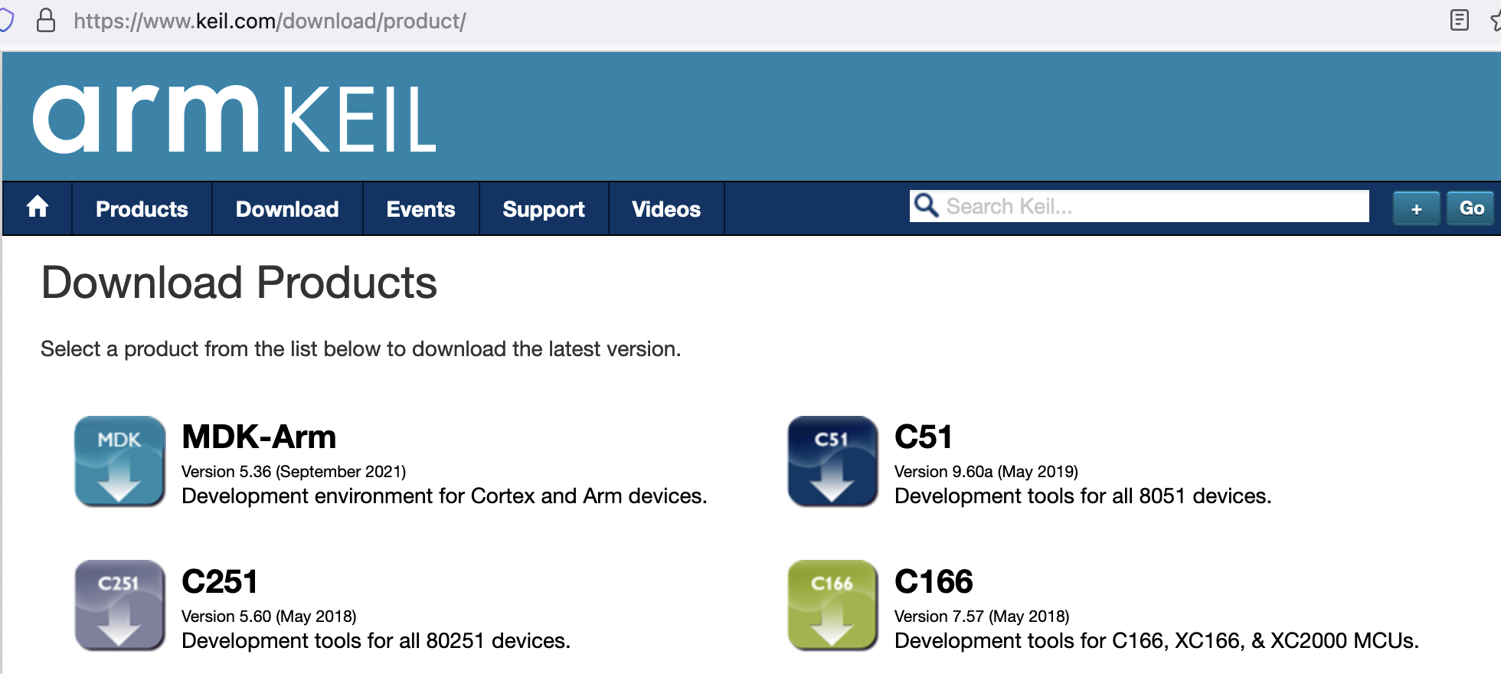
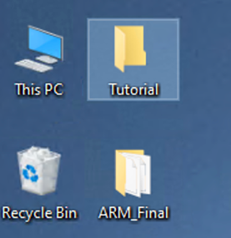
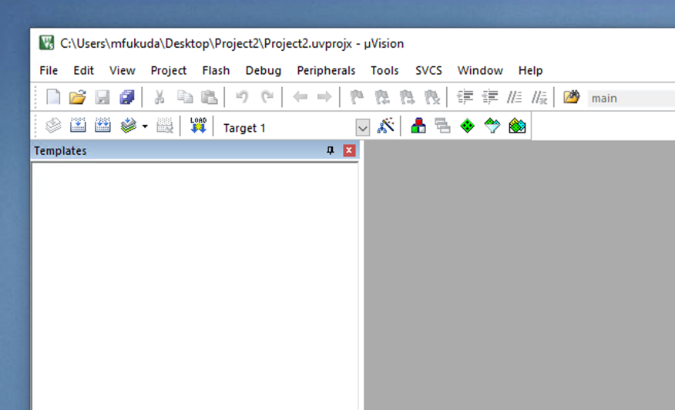
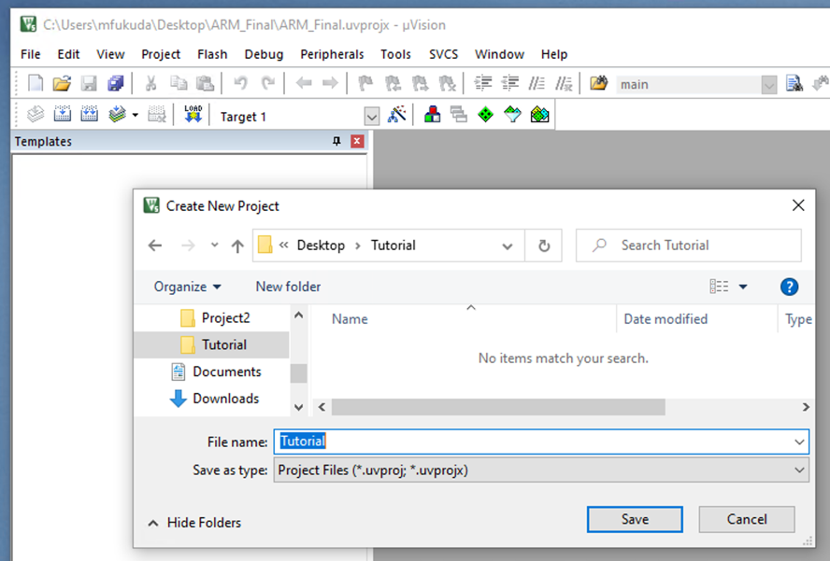
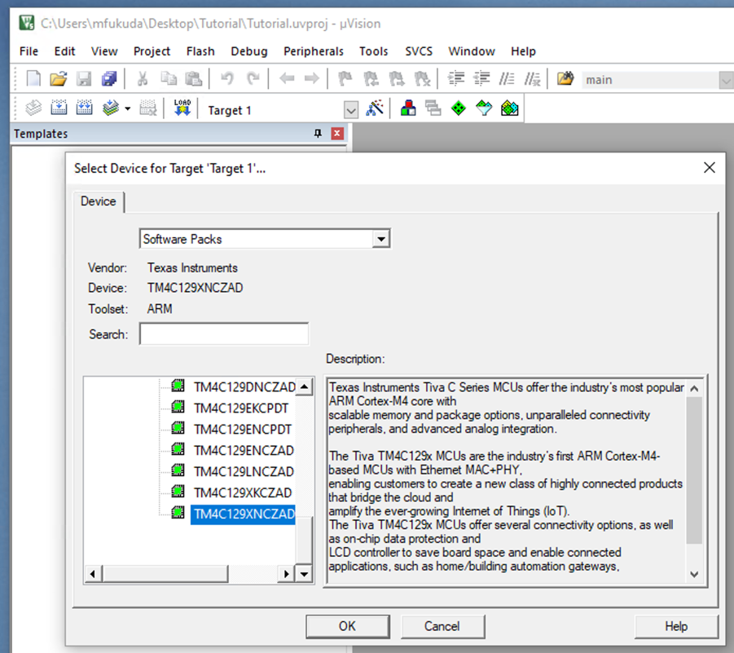
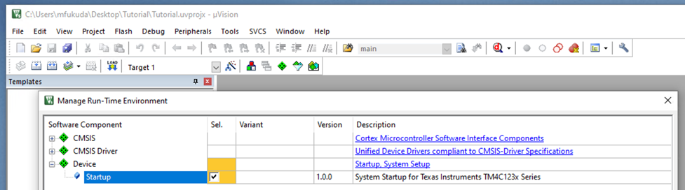
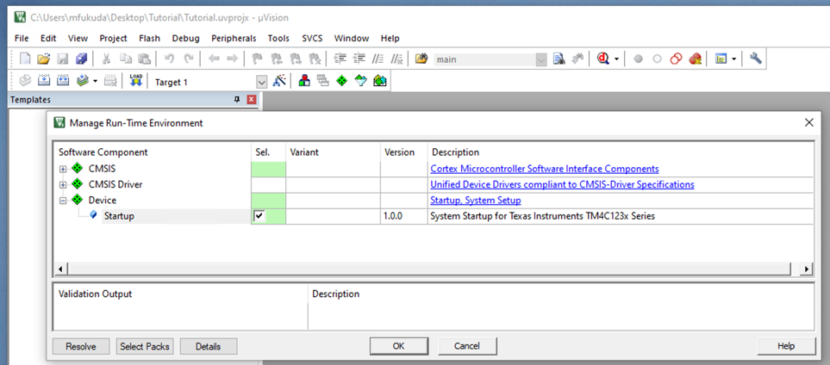
How to Install Keil uVersion
Installation:
UW1-320 windows: already installed
Your own windows: visit https://www.keil.com/download/, choose “Product Downloads” and “MDK-ARM”, and submit your request to download MDK536.EXE.
Project Set-up:
Create a new folder, start Keil uVersion, click “Project” to choose “new uVersion project”, choose the new folder you created, type in a project name in “File name” field, and finally click the “save” button.
In the “Select Device” menu, choose “TM4C1233H6PM” for Lab1b or “TM4C129XNCZAD” for the final project.
In the “Manage Run-Time Environment” menu, check out Device “Startup” and click “resolve”.
1-b
2-a
2-b
2-c

Slide 13
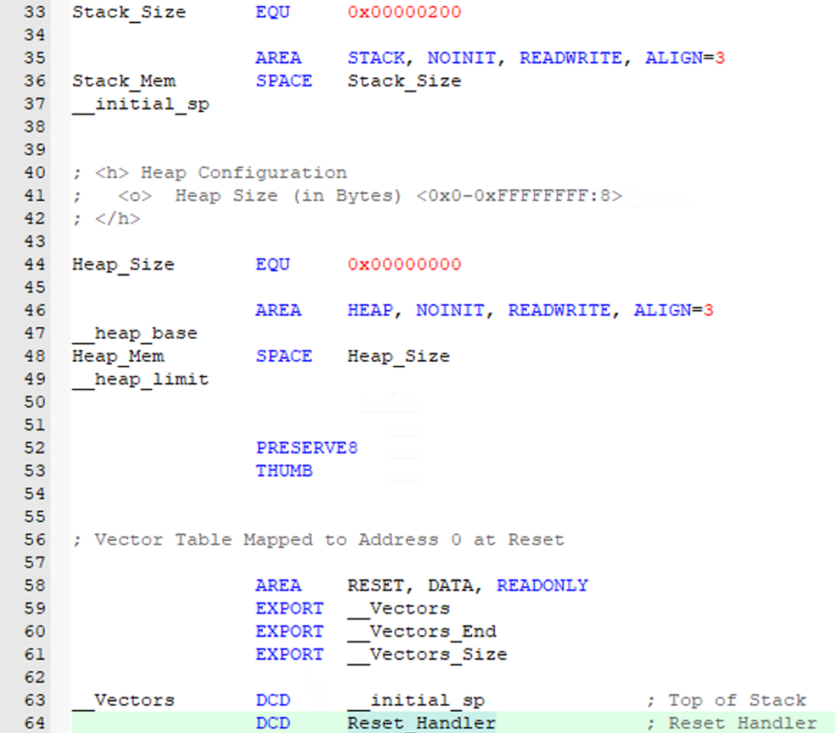
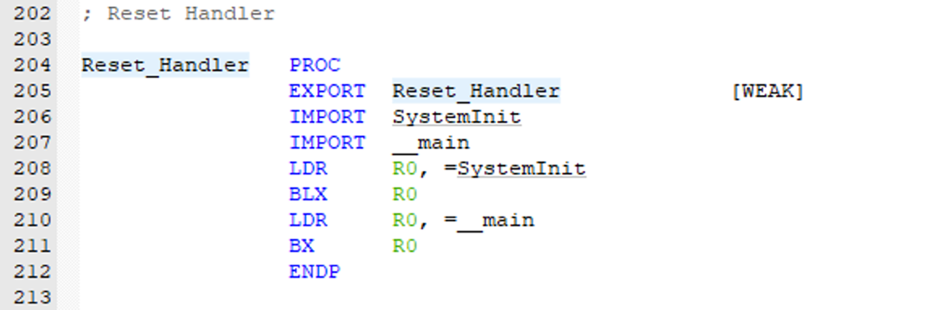
How Your Program is Invoked (Reset Sequence Revisited)
startup_TM4C123.s or startup_TM4C129 will be executed to jump to Reset_Handler
BLX (branch indirect with link) will be executed to call SystemInit (which is in system_TMC4123.c or system_TMC4C129.c) to initialize the system clock.
BX (branch indirect) will be executed to call main (which should be implemented either __main in your_cortex_prog.s or main( ) in your_c_prog.c.
Note: in your final project, you’ll write main( ) in driver.c that intends to verify your Cortex assembly code.

Slide 14
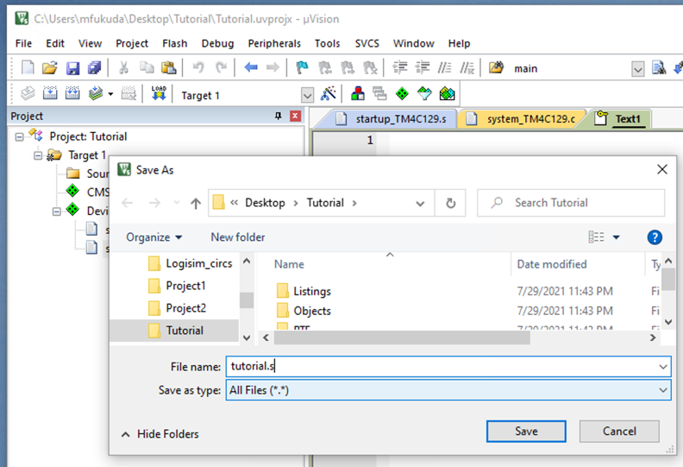
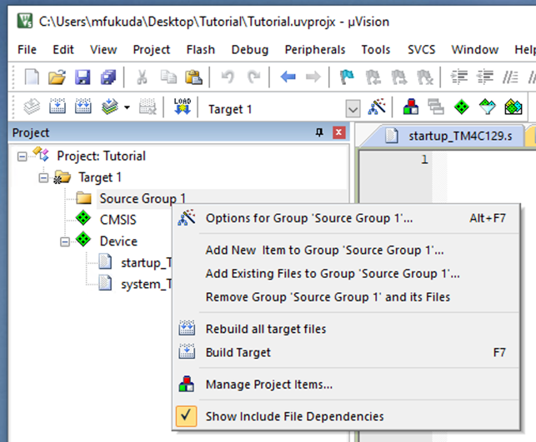
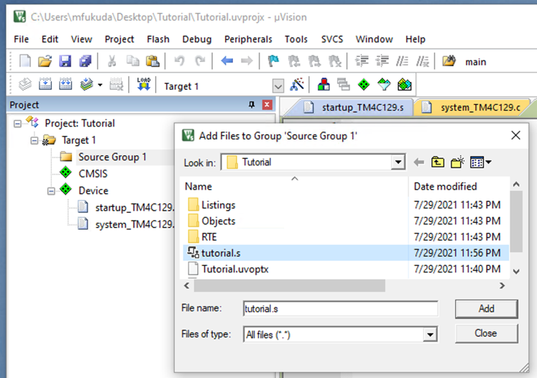
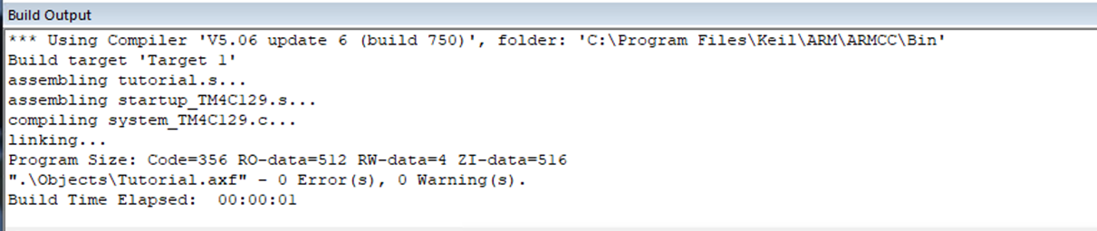
How to Write and Compile
Lab1b
Final Project
You’ll overwrite startup_TM4C123.s
Delete all statements.
Write the 1st assembly program on slide p9.
Create a .s file or .c file:
(a) Click “File” and choose “New” that creates a new file initially named “Text”. Immediately save the file by renaming it with .s or .c and adding it under Target 1/Source Group 1. (b) Right click on Target 1/Source Group 1, choose “Add existing files to Group”, and (c) specify the file name to add it to the group.
Or
Right click on Targe 1/Source Group 1, click on “Add New Item to Group” and elect the .s or .c, write its name in given space, and click “Add”.
Write your code. Then save all files.
1-(a)
1-(b)
1-(c)
2
To build an executable, choose “Project” and “Build Target”.

Slide 15
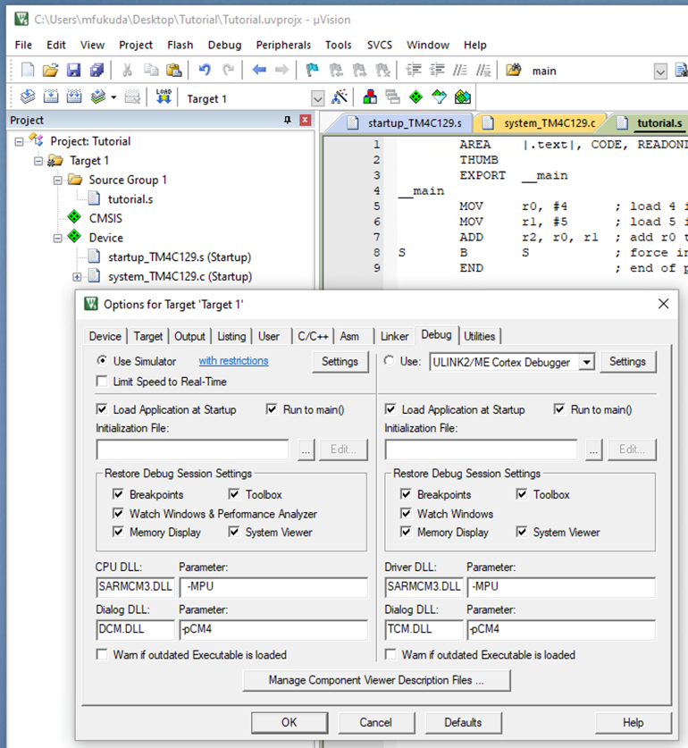
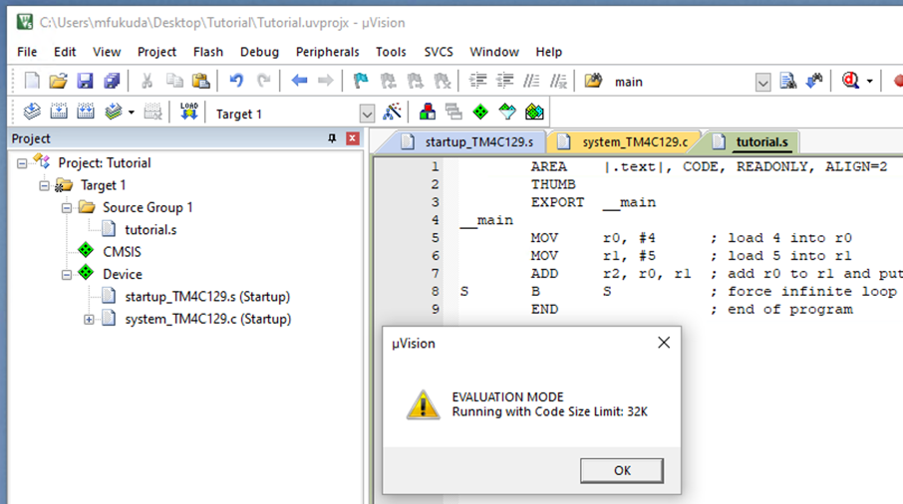
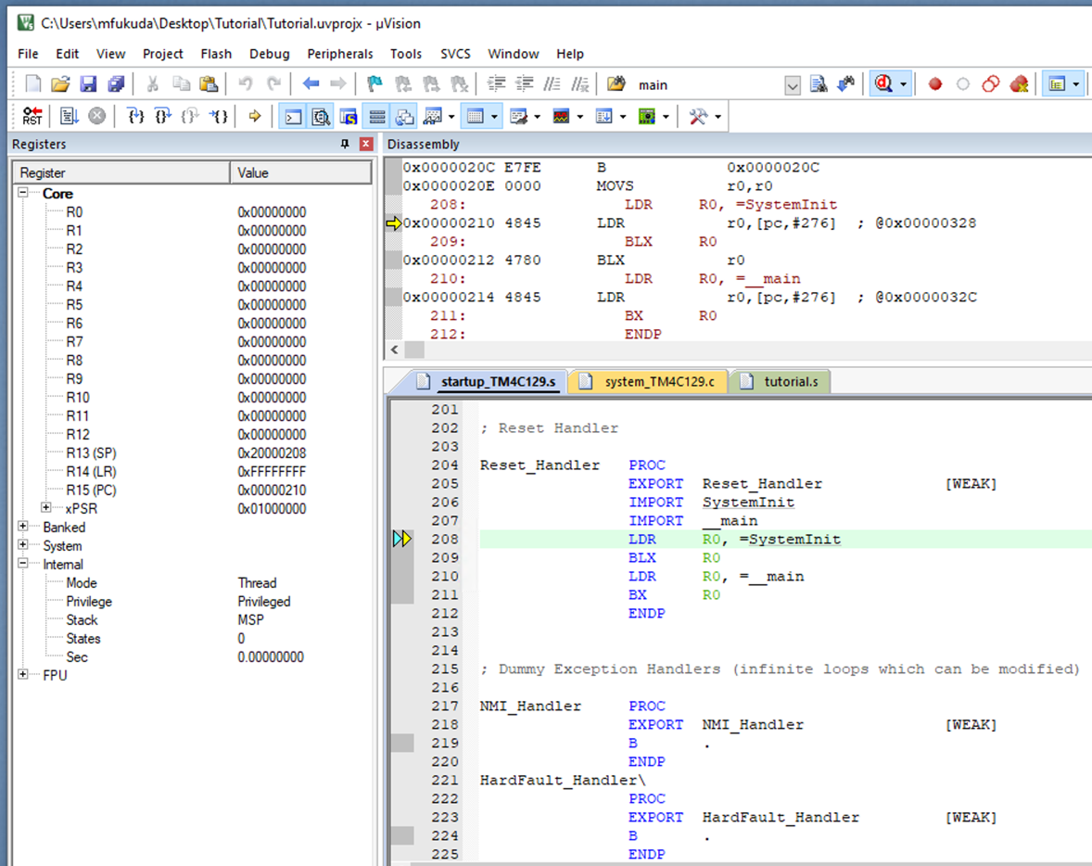

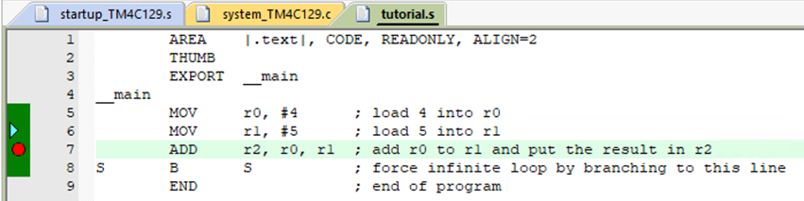
How to Run Your Program
Choose “Project” and “Option for Target”. Click the “Debug” menu and “Use Simulator”
Choose ”Debug” and “Start/Stop Debugging Session”, which then shows a warning message. Simply, click “OK” to start a debugging session.
Use the simulation control buttons.
Reset
Run
Stop
Step one line
Step over the current line
Step out of the current function
Run to the current cursor line
You can use “insert/remove breakout points”. Simply click the left side of the assembly code line#.
2
1
3
4

Slide 16
Summary
What events in general change the processor operating mode from user to OS?
Distinguish three processor operating modes in Cortex-M.
What is the difference between interrupts and exceptions?
How does CPU return back to the user mode, (i.e., unprivileged thread mode in Cortex-M)?
Why does ARM need to distinguish Master Stack Pointer and Process Stack Pointer?
Why do we need EXPORT and IMPORT directives?
Why is the difference between SPACE and DCD/DCB?

